Slide 1


How and why does society affect our body image?

Slide 2
Society has many factors that differentiate and shape our body images.

Slide 3
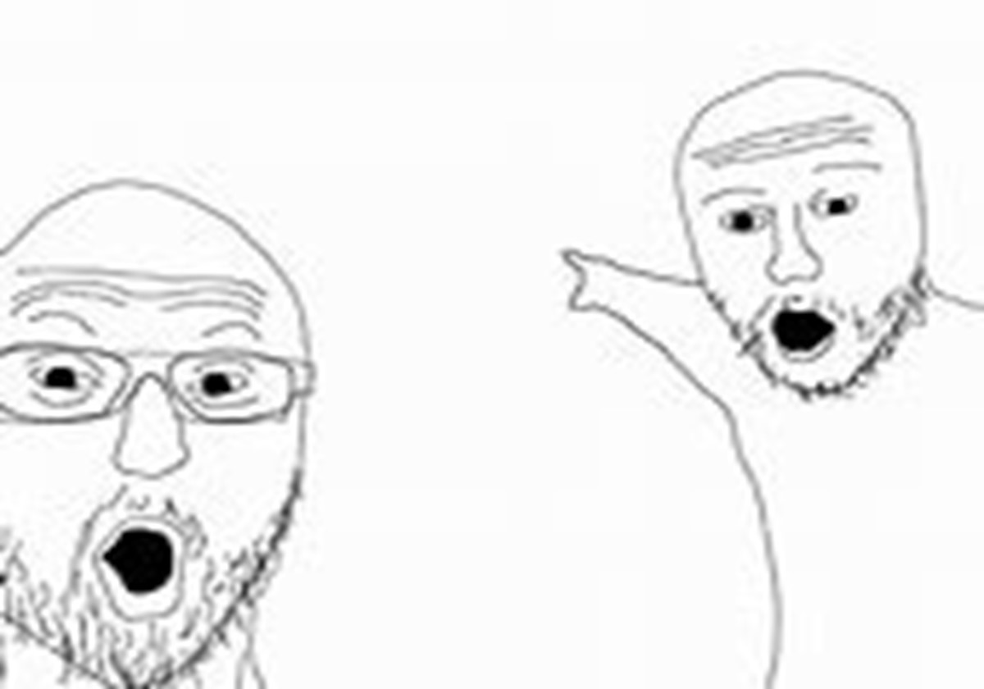



Some examples are:
Peer pressure
Body Shaming
Being Trans
Being Self-aware

Slide 4
But there are ways you can recover

Slide 5
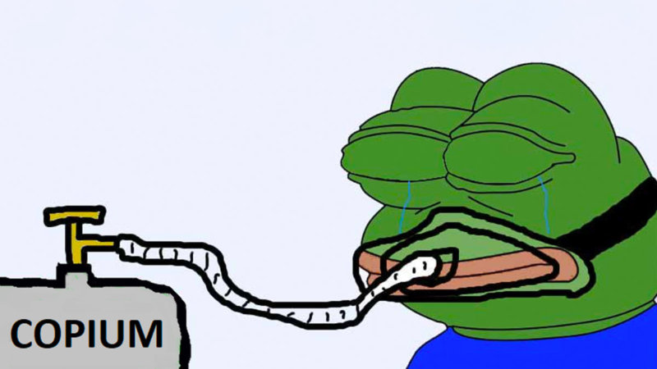

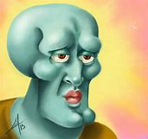
Some ways people cope are:
Influencers
Therapy (unless your card declines, then they redo the trauma)

Slide 6


There are some businesses that benefit by altering your body image.
Like:
They use photoshop and different makeup products than the one they are advertising.
I have proof:
(video)

Slide 7

Liberals like Stacey Abrams also can alter peoples’ body images.
She tried to ban abortion fully, in every state. She used a picture of a fetus that wasn’t developed enough to have a heartbeat, with a heartbeat sound.

Slide 8
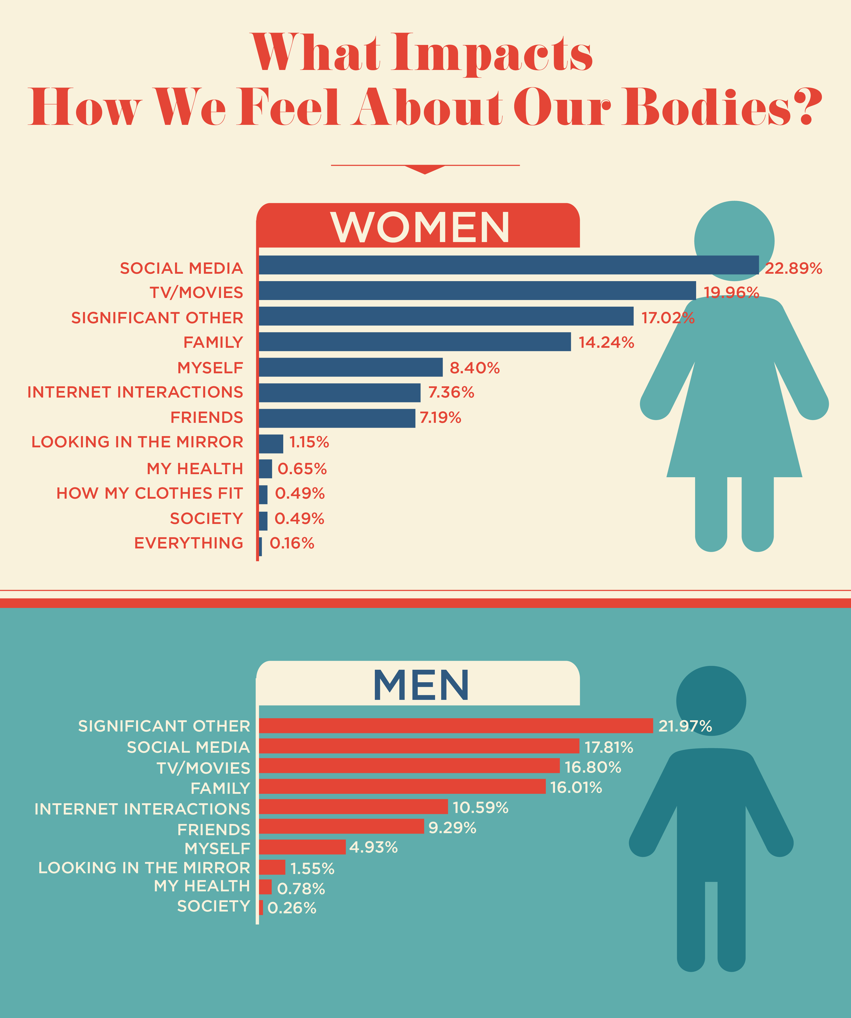
Body image applies to all of humanity.
But the majority of people that feel self-conscious about it or are negatively influenced by others about it are women. That is why cosmetic companies are so wealthy nowadays.

Slide 9
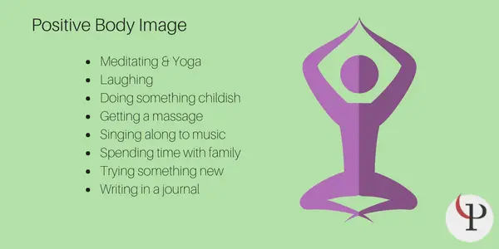
Overall, Body Image is a part of our self-esteem. And it should be taken care of like the rest of it.
Try some healthy activities.
Like:

Slide 10
References (I did not include some details so go to these get the full thing)
https://www.nytimes.com/2010/12/12/fashion/12Studied
Schilder, P. (1935). The image and appearance of the human body. (apa.org)

